Slide 1
Expert System
(ES)

Slide 2
Introduction: Expert Systems
An expert system is a computer program that is designed to hold the accumulated knowledge of one or more domain experts.
A computer program that exhibits intelligent behaviour is an expert system
An ES is a computer program that tries to perform tasks similar to human experts in a specific domain
An ES is meant to solve real-world problems
Notes:
An important characteristics of an ES is that the sequence of steps taken to reach a conclusion is dynamically synthesized with each new case. The sequence is not explicitly programmed during the development of the system. ES can process multiple values for any problem parameter. This case them to pursue more than one line of reasoning hence leading to results of incomplete (not fully determined) reasoning being presented. Problem solving by these systems is accomplished by applying specific knowledge rather than specific technique. This is the key idea in ES technology. It reflects the belief that human experts do not process their knowledge differently from others, but they do possess different knowledge. Therefore, the power of an ES lies in its store knowledge regarding the problem domain; the more knowledge a system is provided, the more competent it becomes. ES may or may not possess learning components. However, one they are fully developed, their performance is evaluated by subjecting them to real world problem solving situations.

Slide 3
Famous ES
MYCIN
  Medical expert system
  Diagnoses bacterial infections and recommends antibiotic therapy.
  Performance was better than the average clinician*
DENDRAL
  Molecular structure and chemistry
  Attempts to identify the molecular structure of unknown compounds.
*a doctor having direct contact with patients rather than being involved with theoretical or laboratory studies.

Slide 4
Famous ES
XCON and XSEL
  XCON helps configure large computer systems
  XSEL helps the sales persons to select component for a VAX system
Prospector
  Helps geologists locate ore deposits.
EL
  Analyzes electronic circuits

Slide 5
Miscellaneous applications
Weather forecast
  current weather situation locally + other parts of the country = weather prediction for the future
Aircraft identification
  Various features and characteristics of the airplane can be entered to get an identification of the aircraft
Battlefield management
  Different forces can enter the current situation and ES can provide an analysis and recommendation for alternative actions

Slide 6
Benefits of ES
Permits non-expert to do the work of experts
Improve productivity by increasing work output
Save time in accomplishing a specific objective
Simplify some operations
Automate repetitive, tedious, or overly complex process
Capture and store of useful knowledge
Make expert knowledge available to a wider audience

Slide 7
The Down Side
Developing ES is extremely difficult
Extracting the knowledge of limited available experts is a long tedious job and coding that knowledge is a major chore (job).
ES are expensive
ES are not 100% reliable

Slide 8
Stand-alone vs Embedded Expert System
Stand-alone
  The ES that runs on PC, minicomputer or mainframe computer and the computer is totally dedicated to it.
  The stand-alone expert System is independent in its application
Embedded
  The ES which is part of another larger program and provides its output to the larger program is called embedded expert system

Slide 9
Knowledge Engineering (1)
The process of gathering knowledge from a domain expert and codifying it according to the formalism* is called knowledge engineering
The tasks and responsibilities of a knowledge engineer involve:
  Ensuring that the computer has all the knowledge needed to solve a problem
  Choosing one or more forms to represent the required knowledge
  Ensuring that the computer can use the knowledge efficiently by selecting some of the reasoning methods.
*a description of something in formal mathematical or logical terms.

Slide 10
Knowledge Engineering (2)

Slide 11
Components of an Expert System
Knowledge base
Inference engine
User interface
Working storage or ‘Fact-base’ or ‘Data base’

Slide 12
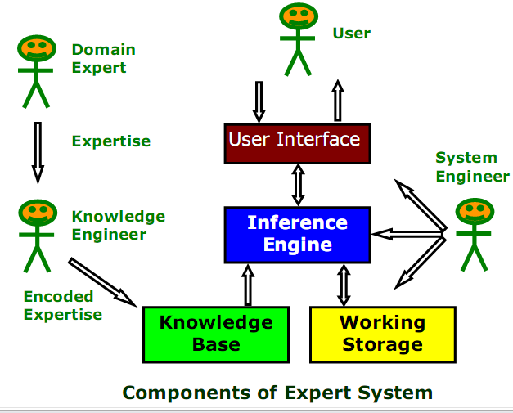
Components of an Expert System

Slide 13
Knowledge base (a heart of ES)
  Knowledge base is the collection of facts and rules which describe all the knowledge about the problem domain.
  The most preferred way of representing knowledge is production rules
  Rules are written in IF-THEN form

Slide 14
Knowledge base ….
Example Rule 1:
  IF the animal lives in water
  AND the animal breaths water
  THEN the animal is a fish, CF 1.0
Example Rule 2:
  IF the patient has frequent headache
  AND the patient has blurred distant vision
  THEN the patient needs glasses, CF 0.9

Slide 15
Inference engine
  Inference engine is the part of the system that chooses which facts and rules to apply when trying to solve the user’s query
  Also called rule interpreter
  It is the main part of the ES software that implement searching and pattern matching algorithms to solve the problem
Techniques used by inference engine are:
  Forward chaining
  Backward chaining
  Tree search

Slide 16
Inference engine: forward chaining (1)
In forward chaining, the inference engine begins with some initial information and work forward, attempting to match that information with a rule.
Here, the inference engine attempts to match a fact or statement in the database to the situation stated in the left-hand or IF-part of the rule

Slide 17
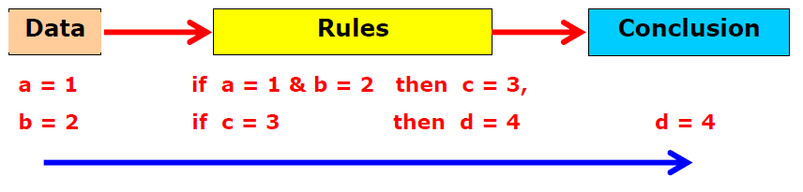
Inference engine: forward chaining (2)
If match is found, the rule is fired
If a new fact is produced as a consequent, it is added to the knowledge base which may then be used to search out the next appropriate rule
It is also called data driven approach to inferencing

Slide 18
Inference engine: forward chaining (3)
Initial Facts
F
L
Inferred Facts
I
N
G
H
RULE BASE
IF K & L THEN J
IF F & J THEN M
IF F THEN I
IF L & I THEN N
IF N THEN G
IF M THEN G
IF G THEN H
OBJECTIVE:
PROVE HYPOTHESIS* H
*hypothesis: a supposition or proposed explanation made on the basis of limited evidence as a starting point for further investigation.

Slide 19
Forward chaining example
RULE 3
F
I
RULE 4
RULE 5
RULE 7
N
G
H
AND
L
IF K & L THEN J
IF F & J THEN M
IF F THEN I
IF L & I THEN N
IF N THEN G
IF M THEN G
IF G THEN H
Initial Facts
F
L
Inferred Facts
I
N
G
H

Slide 20
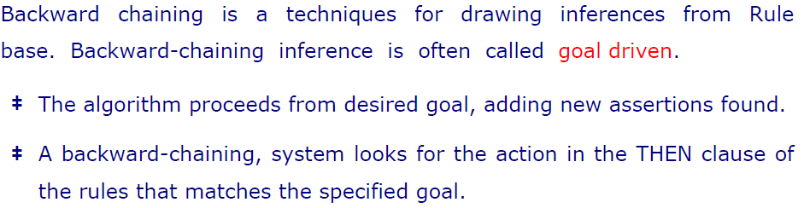
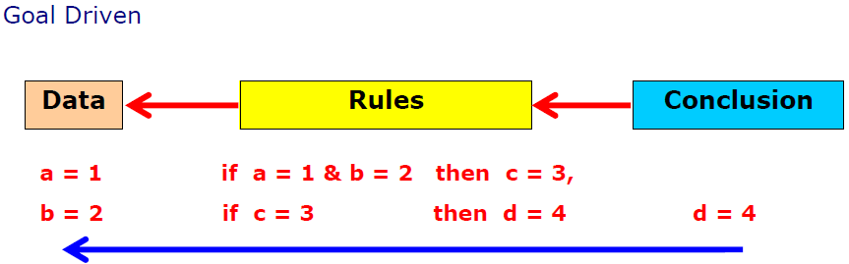
Inference engine: backward chaining

Slide 21
Inference engine: backward chaining
If a match is found, the database is updated according to the condition or premise
The chaining process continues with the system repeatedly attempting to match the right-side of the rule against the current system status
The corresponding IF-part of the rules matched are used to generate new intermediate hypothesis or goal states which are recorded in the database
The chaining process is continues until the hypothesis is proved

Slide 22
Inference engine: forward vs backward chaining
In large system forward chaining is not suitable because it generates many sequences of rules and as a result the system is slow
Backward chaining gets a fixation on a particular hypothesis and continue to explore it although the data available to support it may not be there. The system lacks the ability to know when to switch to an appropriate search sequence
Some systems use both the methods

Slide 23
User interface
  User interface is the part of the system which takes in the user’s query in a readable form and passes it to the inference engine.
  It then displays the results to the user.
  The interface can be either GUI or CLI
  It usually
    Asks question from the users
    Presents menu choices to the users for proper choices

Slide 24
Data base or Fact base
  It is also called working memory or storage of the expert system that contains the current state of the solution of the problem.
It is termed as fact base as well because it contains the facts about the initial states of the problem
The inference engine matches the facts stored in the data base with the rules stored in the knowledge base and if match is found then the database is updated

Slide 25
Desirable ES features
Explanation Facility
  Improves the users confidence level esp when the output is different from what is expected
Ease of modification
  Easy and quick data update
Transportability
  Platform independent
Adaptive learning ability
  Learn from their experience

Slide 26
Dealing with uncertainty
Dealing uncertain situation is one of the main features of expert system in which it deals with incomplete information to reach some conclusion
Traditional algorithmic software's cannot deal with incomplete information
It’s the artificial intelligence software, specially expert systems, that reach some conclusion in any case weather the information are complete or not.

Slide 27
Dealing with uncertainty …
Uncertainty can be dealt using
  Certainty factor
  Probability
  Fuzzy logic

Slide 28
Certainty factor
Certainty factor is a measure of the confidence you have that a particular fact or rule is true or not true
For example
  IF the student is sneezing
  AND has a runny nose
  AND has watery eyes
  THEN the student has a cold, CF=0.5

Slide 29
Probability
Probability is a number that expresses the chance of something occurring or not occurring
If we ask 10 students whether they can program in BASIC language and 3 of them say they can. Then the probability is
  P(X)=(number of outcomes favoring the occurrences )/(total number of events)
  i.e
    P(BASIC)= 3/10 =0.3

Slide 30
Fuzzy logic
Conceived by mathematician and scientist Lofti Zadeh for dealing an inexact or unreliable information
Here, numerical ranges, 0 to 1, are assigned to concepts such as height, age, beauty etc.
It tries to clarify things like how tall is tall?
  Example: tall might be expressed as value of X between 5’10’’ to 6’2’’. X=0 means X is not in the range.

Slide 31

Why use Expert Systems?
Experts are not always available. An expert system can be used anywhere, any time.
Human experts are not consistent
Experts may not be good at explaining decisions
Cost effective

Slide 32
Legal and Ethical Issues
Who is responsible if the advice is wrong?
  The user?
  The domain expert?
  The knowledge engineer?
  The programmer of the expert system shell?
  The company selling the software?

Slide 33
Expert Systems on the Web
Whale watcher
  http://www.aiinc.ca/demos/whale.html
Forecasting & Planning Solutions to businesses
  http://www.vanguardsw.com/ decisionscript/examples.htm
Knowledge automation Expert System technology
  http://www.exsys.com/demomain.html
Diagnosing Why a Car Won't Start
  http://www.expertise2go.com/webesie/car
Choosing a Basic Dinner Wine
http://www.expertise2go.com/webesie/wine

Slide 34
References
Louis E. Frenzel, Jr. Crash crouse in artificial intelligence and expert system, chapter No.4

Slide 35
Expert System Development (ES)

Slide 36
Agenda
Development of expert system
References
End

Slide 37
Creating an Expert System
General guidelines for the development of an Expert System are:
  Identifying the problem and need
  Determining the suitability of the problem
  Consider the alternative
  Compute the ROI(Return On Investment)
  Select the development tool
  Perform the knowledge engineering
  Design the system
  Compute the development
  Test and debug the system
  Maintain the system

Slide 38
Identifying the problem and need
A real problem need to be identified and solved
Decision is made about:
  What the problem is
  Why such a system may be helpful
The problem should be suitable for the solution by expert system

Slide 39
Determining the suitability of the problem
Problem is looked in more detail weather it is suitable for the expert system to be solved or not
For example:
  The target group of people of the expert system have their own computers or not or they have access to the computer or not

Slide 40
Consider the alternative
The solution provided by using conventional softwares should not be neglected and need to be taken into account (for consideration) if they are performing well
If equally or satisfactory alternatives are available then why A.I based expert system are favored

Slide 41
Computer the ROI
If expert system is the final solution the the next step is to computer the Return on Investment
Cost/benefit analysis is done
Cost of
  Planning/feasibility study
  Designing (designers) cost
  Programming cost
  Operating cost
  Cost in case of failure

Slide 42
Select a development tool
An expert system development tool is a set of software packages that are used to enter an expert’s knowledge into a database without having to program
Tools available
  Rule-based tools (mostly)
  Frame-based and semantic network based (for large and complex systems)

Slide 43
Perform the knowledge engineering
Knowledge is acquired
A suitable knowledge representation scheme is selected
Knowledge is represented mostly with production rules

Slide 44
Design the system
Start basic design for the knowledge acquired and engineered
Flowcharts, matrices and decision tables are designed to organize and understand the knowledge
Create a prototype of one segment of the system

Slide 45
Complete the development
Expand the prototype into the final system
Perform the coding of each rule at a time and check it to know weather working properly or not

Slide 46
Test and debug the system
Test the system
If an error is encountered during testing try to debug it

Slide 47
Maintain the system
Keeping the expert system in its working condition is called maintenance of expert system

Slide 48
References
Louis E. Frenzel, Jr. Crash crouse in artificial intelligence and expert system, chapter No.5

